Slide 1


Map For All
About Best Navigation service
MAP FOR ALL
A quick, convenient
navigation service

Slide 2







Contents
Map For All
About
Map For All
Introducing
Features
Our
Service
Applying
To daily life
The purpose, target users,
and expected benefit.
The main functionalities
and sensors used.
Detailed use of the
application.(diagrams)
Concept videos and
UI designing descriptions.

Slide 3








A navigation
service with
a new concept
For those who feel inconvenient with
existing Navigating applications.
Best Driver
Improving the limitation that the existing app applies same standards for all users who has different characteristics. For those who have small pace with slow walking speed, for those who need to move in wheelchair or crutches, and for those who need to carry huge suitcase,
‘Map For All’ is available for ALL OF THEM. As personal customization is popular in this society, ‘Map For All’ respect diversity through personal customization.
Notes:
purpose: to let the users who were 소외되었던 exsiting map application such as who has small pace, slow walking speed, need to move in wheelchair or crutches or who has a huge luggage to carry.
All people including those user also can 사용하다 this application.

Slide 4






Personalize
Convenient
Walking speed & Condition
UX/UI & Sharing system
Best Driver
By providing customized personal functions,
you can have better travel experience.
Customized service with the option for the person
who has difficulty in using smartphone.
Sharing information about street condition between users
Notes:
Benefit. We can use personalized customized function for the all users by calculating each walking speed and checking the conditions the user is 겪고 있는.
+ the convenient interface which is also can be customed for individual through checking the 스마트폰 약자, managing font size and more.
We also contains sharing system for the application users so that everyone can 접근하다 the 실시간 소식에.

Slide 5





1. Reflect Individual Walking Speed
Calculate individual walking speed
Through Acceleration Sensor
Your average speed is
With the Acceleration Sensor, GPS, Gyro sensor
4KM
Per hour
Acceleration Sensor
- Detect Motion of Smartphone through x, y, z coordinates.
Gyro Sensor
Measure the angular velocity, the speed of
rotation per hour
Estimated arrival times are increasingly accurate based on your data.
GPS
Determines location of the user from satellites
floating around the Earth
+Calculate Stride length by cadence(steps per minute)

Slide 6












2. Providing Optimal Path
with Optimal Service
Based on Personal Conditions
Font size, walking speed(on the basis of 1),
Arrow Tutorial

Slide 7
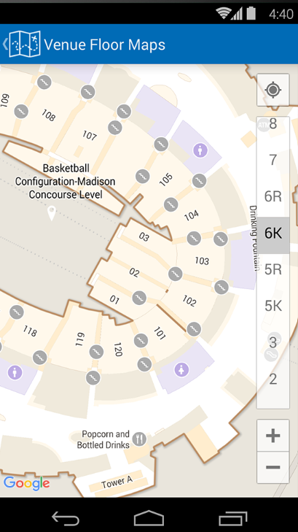
3. Providing Information of
Stairs/elevators/escalator/obstacles
Using building’s interior perspective
& Big Data from a public site
Guiding the path based on personal option
that user has chosen
Collect Big data of the obstacles(Construction sites,
natural disasters, road damage, etc.) in the street
Through the information
TOPIS(Traffic Information Division) &
Ministry of Land, Infrastructure and Transport
Notify whether there are obstacles in the building by
reference to building perspective view

Slide 8
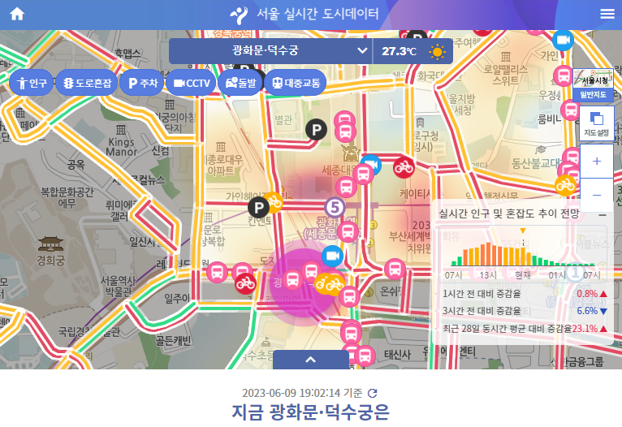

4. Providing population density
City website
Map For All
Identify population density
(only for areas which have density information –
ex. available on the ‘Seoul Open Data Plaza website’)

Slide 9



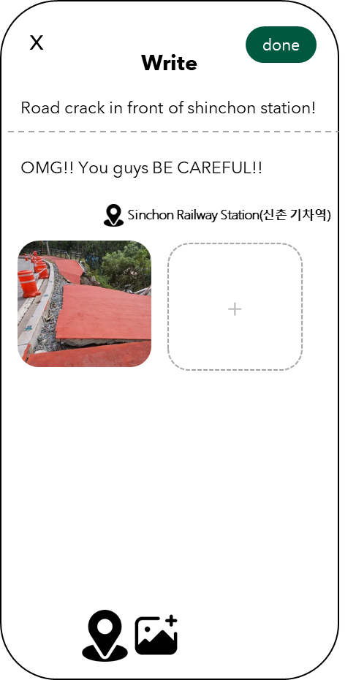
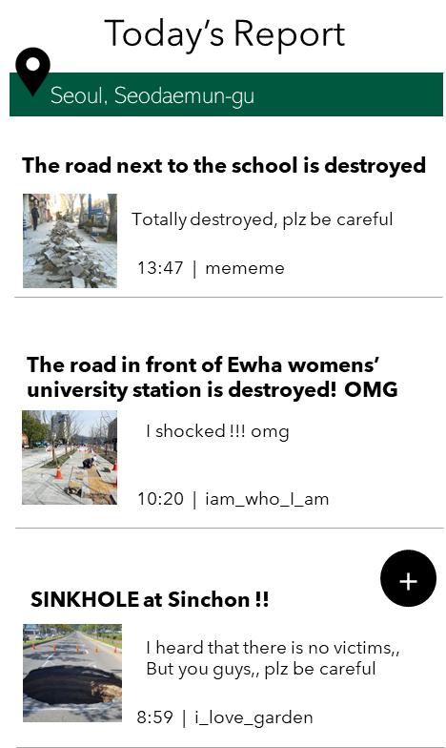

5. User-based function
Today’s Report
Complement big data from city hall using user-based page
Users can both report and read
real-time accident news and obstacles

Slide 10


6. Display the user's indoor location
Use 'indoor positioning’ –using wifi
-Can show precise user location indoors
as well as outdoors
-Exceeded the limit of
‘GPS sensor only works externally’
-Estimates the user's location
by measuring the signal strength of the Wi-Fi
(The signal strength is inversely proportional
to the distance between the user and the AP.)

Slide 11
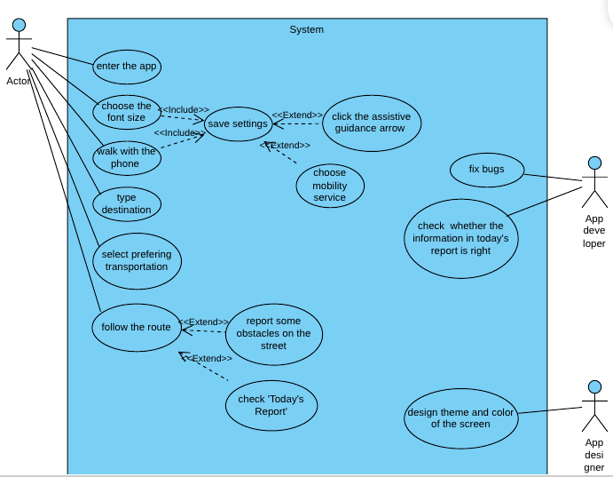
Diagrams
-Usecase Diagram

Slide 12
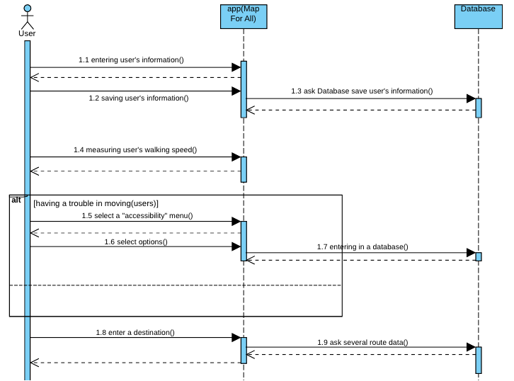
Diagrams
-Sequence Diagram

Slide 13
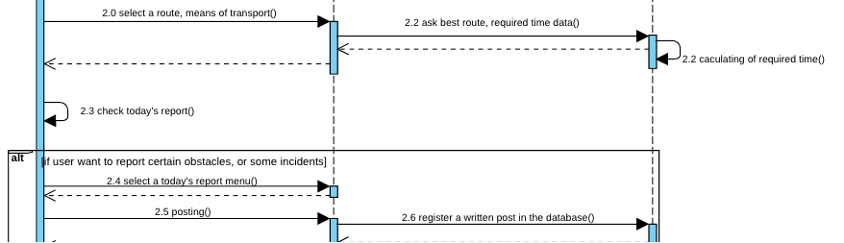
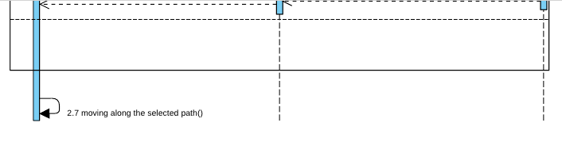

Slide 14
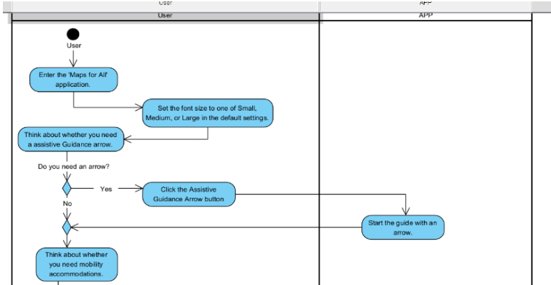
Diagrams
-Activity Diagram

Slide 15
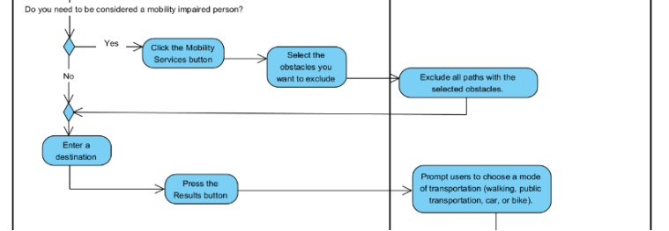
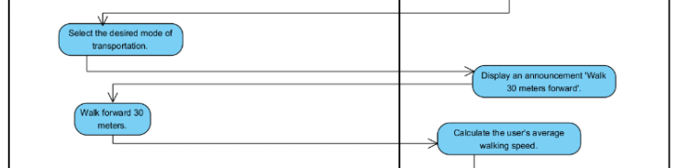

Slide 16
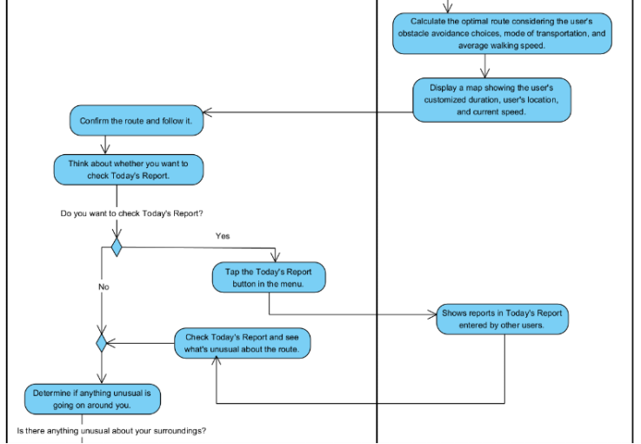

Slide 17
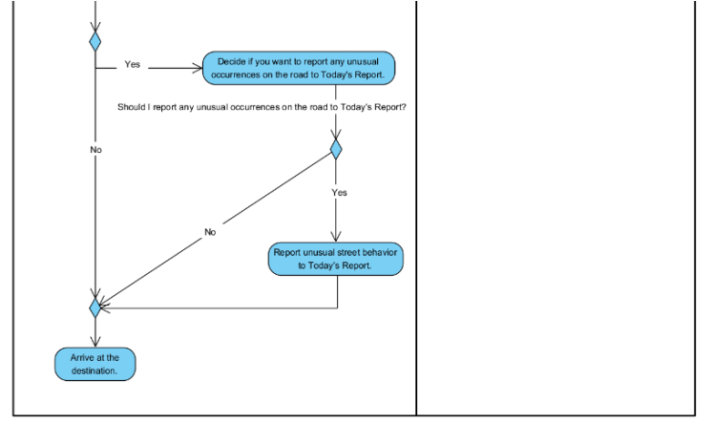

Slide 18
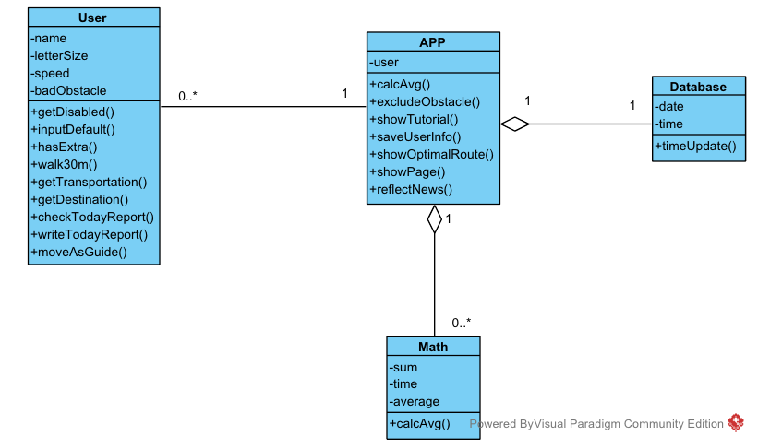
Diagrams
-Class Diagram

Slide 19
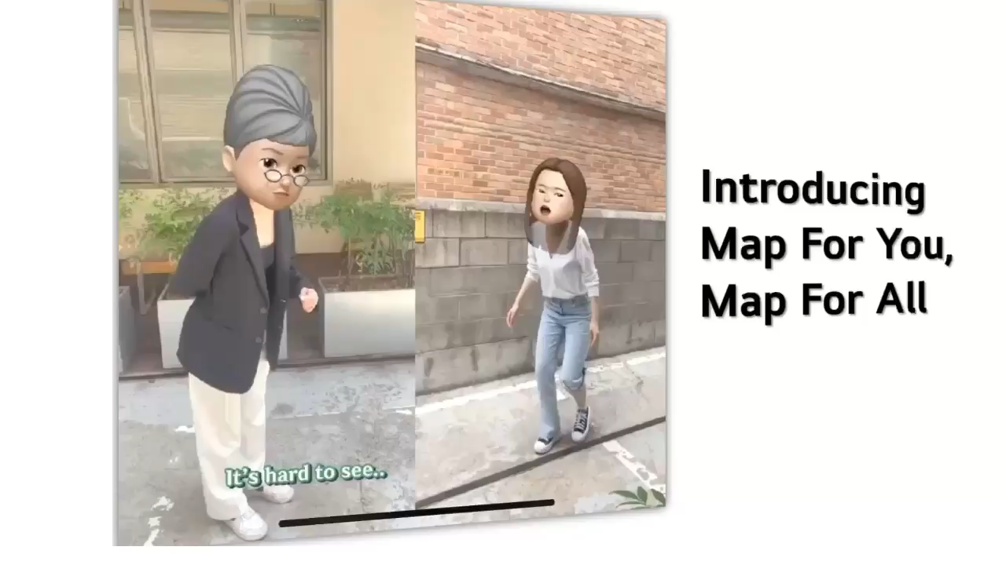
Concept Video

Slide 20

Thank you for listening !

